Slide 2
Finding a number (optimally):
Guessing game: I’m thinking of a number. You guess. I will tell you “higher” or “lower” until you guess the number.
If I’m thinking of a number between 1 and 16, at most how many numbers will you have to guess?
2⁴ = 16 (coincidence?)
If I’m thinking of a number between 1 and 64, at most how many numbers will you have to guess?
2⁶ = 64 (coincidence?)
If we have a FULL and COMPLETE binary search tree with n nodes:
At most it will take log₂ n to find/add/delete a node from the tree

Slide 3
Create a tree by inserting the following data
[1 | 2 | 4 | 7 | 13 | 24 | 29 | 32 | 36 | 42 | 55]
1
2
4
7
13
24
29
32
36
42
55
How many steps to find 24 in this tree? Is there a better way?

Slide 4
BST Example
[1 | 2 | 4 | 7 | 13 | 24 | 29 | 32 | 36 | 42 | 55 ]
How many steps to find 55 in this tree?
At most, how many steps are necessary to find any number in this tree?
Between 2^{n-1} and 2^{n} nodes, it will take at most n steps… if tree is balanced
Balanced: at any node, the height of the left subtree and the height of the right subtree differ at most by 1
24
4
36
2
13
29
55
1
7
24
42

Slide 5
Is this tree balanced? (Hint: Nope!)
5
<-root
3
12
7
18
15
12
Implement the following:
Node *tmp = root->right
root->right = tmp->left
tmp->left = root
What tree results?
18
5
3
7
15

Slide 6
How ‘bout this?
5
<-root
3
12
7
18
9
After Step 4.
Final
Node *tmp = root->right->left
root->right->left = tmp->right
tmp->right = root->right
root->right = tmp
root->right = tmp->left
tmp->left = root;
root = tmp
5
7
3
7
5
12
12
3
9
18
9
18

Slide 7
void SLL::func(int x[], int y[], int s1, int s2) {
int c1=0;
int c2 = 0;
int d;
x[0] < y[0]?d = x[c1++]:d=y[c2++];
first = new SNode(d);
SNode *tmp = first;
size = 1;
while (c1 < s1 || c2 < s2) {
while (c1<s1 && x[c1] == d) {
c1++;
}
while (c2<s2 && y[c2] == d) {
c2++;
}
if (c1 < s1 && c2 < s2 ) {
x[c1] < y[c2]?d = x[c1++]:d=y[c2++];
tmp->next = new SNode(d);
tmp = tmp->next;
size++;
}
else if (c1 < s1) {
d = x[c1++];
tmp->next = new SNode(d);
tmp = tmp->next;
size++;
}
else if (c2 < s2) {
d = y[c2++];
tmp->next = new SNode(d);
tmp = tmp->next;
size++;
}
}
last = tmp;
}

Slide 8
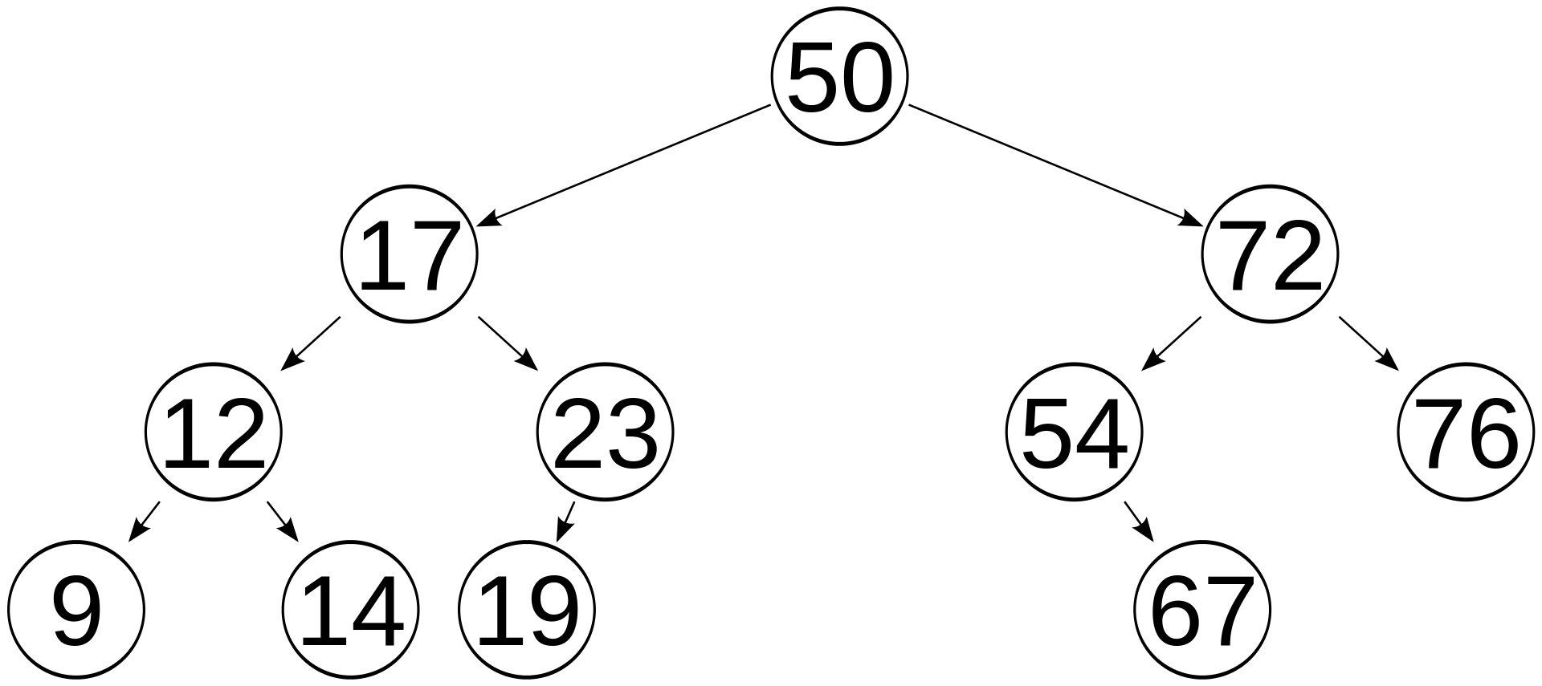
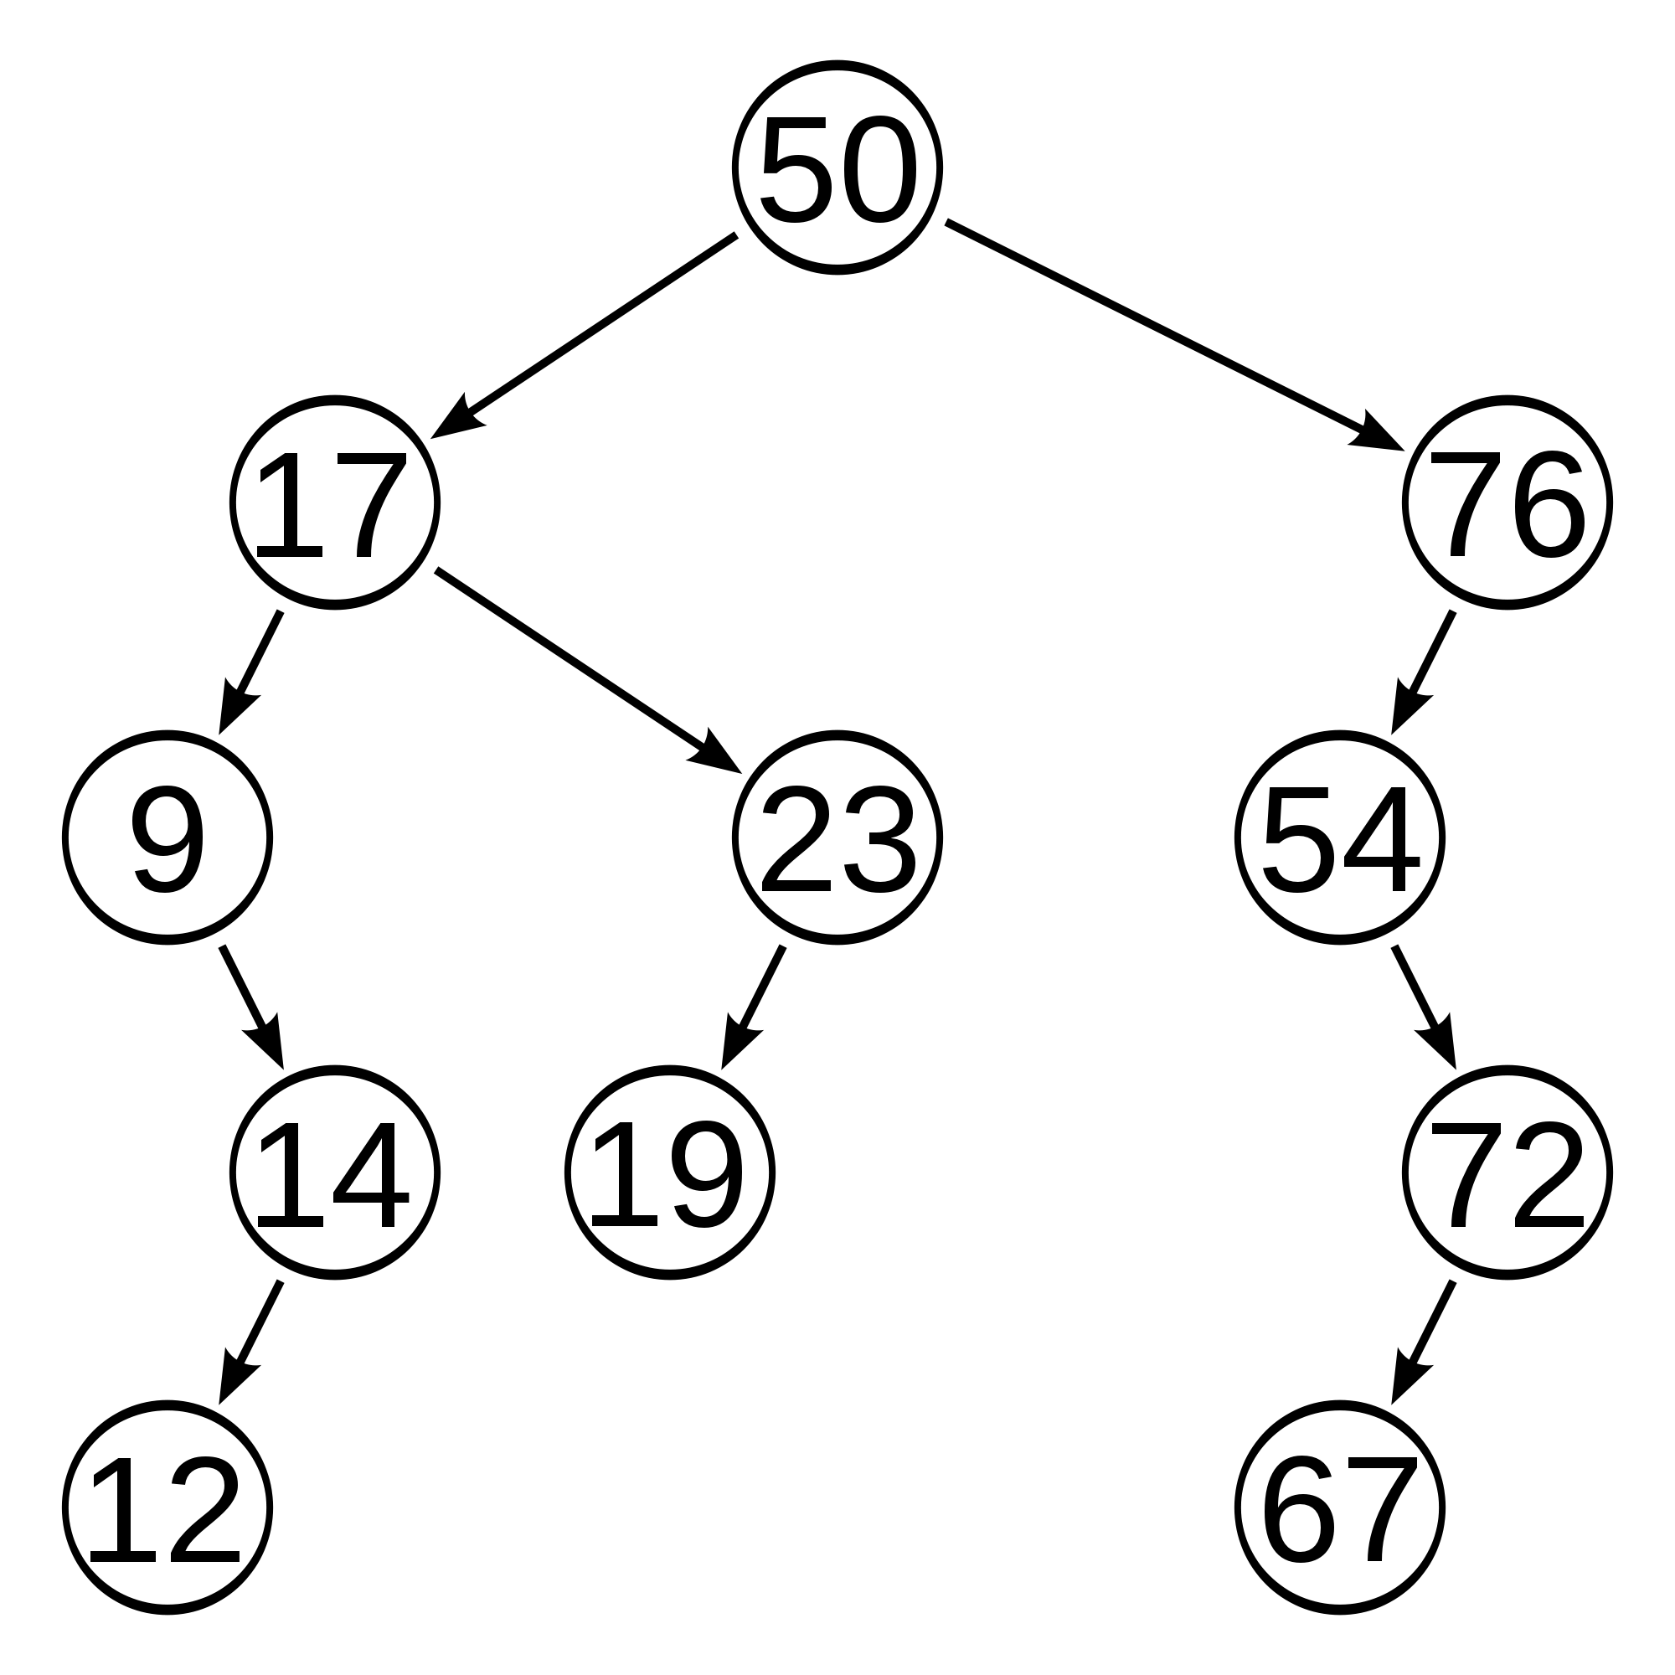
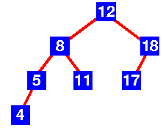
AVL Trees:
Balanced binary search tree
Makes sure that every node can be reached in O(log n) or less
Named after inventors: Adelson-Velskii and Landis
To stay balanced, the AVL tree maintains the following properties:
The left subtree and the right subtree of every node in the tree differs in depth by at most 1
Every subtree is an AVL tree

Slide 9
AVL Trees:
Searching: done like a binary tree
Traversal: done like a binary tree
The sticky ones: Insertion and Deletion of nodes
Add to each node a “Balance Factor”
The height of the left subtree minus the height of the right subtree
0
0
1
0
1
-1
0
0
0
0
0

Slide 10
Insertion and maintaining balance:
Inserting may cause tree to become unbalanced
At least one node becomes 2 or –2
Only nodes on the path from inserted node back up to root node could have possibly changed in height
After the insert, travel up parents to the root, updating heights if necessary
If a node’s balance (h_{left} – h_{right}) is 2 or –2, adjust tree by rotation around the node
-1
0
2
0
1
-2
0
0
0
0
-1
68

Slide 11
Rules for insertion:
Assume we are inserting node w into a tree:
1. Perform standard BST insert with node w.
2. Starting from w, travel up and find first unbalanced node (2 or -2).
Let z be the first unbalanced node
y be the child of z that’s on the path from w to z
x be the grandchild of z that comes on the path from w to z
Re balance tree by rotating appropriately around z
There are 4 possible cases that must be handled as x, y, and z can be arranged in 4 ways:
1. y is the lef child of z and x is the left child of y (left-left)
2. y is left child of z and x is right child of y (left-right)
3. y is the right child of z and x is right child of y (right-right)
4. y is right child of z and x is left child of y (right-left)
In all 4 cases, we only need to rebalance at z and the complete tree becomes balanced

Slide 12
Insertion: rotations (the fun part)
Left-left rotation:
The unbalanced node is unbalanced on its left side (both nodes unbalanced negatively
The right child is unbalanced on its left side (has a greater right height than left height):
-2
12
0
5
12
-1
18
3
5
7
18
3
7
15
15
inserted
Single left rotation:
12 becomes new root
5’s right child becomes 12’s left child
12’s left chld becomes 5
How many steps?

Slide 13
Insertion: rotations
Right-right rotation: pretty much the same thing
The unbalanced node is unbalanced on its right side
The left child is unbalanced on its right side (has a greater left height than a right height):
2
0
18
14
1
0
14
21
7
18
7
17
5
17
21
5
inserted
Single right rotation:
14 becomes new root
18’s left child becomes 14’s right child
14’s right chld becomes 18

Slide 14
Left-Right rotation (LR)
If we have a negative balance at the root, and a positive balance at the right child
5
-2
12
2
-1
5
3
12
1
18
7
18
3
7
9
9
inserted
Simple left rotation doesn’t work:

Slide 15
Instead: Do a double-rotation
Do a right rotation on the right subtree
And then do our typical left rotation on the root:
-2
-2
7
0
5
5
0
1
3
-1
5
12
3
12
7
12
3
9
18
7
18
9
9
18

Slide 16
Code for rotations:
struct node {
int key;
struct node *left;
struct node *right;
int height;
};
node *rightRotate(node *y){
node *x = y->left;
node *tmp = x->right;
// Perform rotation
x->right = y;
y->left = tmp;
// Update heights
if (y->left->height > y->right->height) { //why did we look at y first?
y->height = y->left->height + 1;
}
else {
y->height =y->right->height + 1;
}
if (x->left->height > x->right->height) {
x->height = x->left->height + 1;
}
else {
x->height = x->right->height+1;
}
return x; // Return new root
}

Slide 17
Try:
17
17
12
22
12
20
7
14
20
7
14
19
22
19

Slide 18
Try:
20
20
20
32
7
35
7
32
7
3
26
35
3
32
48
3
26
48
34
48
26
34
51
35
51
34
51
Notes:
Stopped here

Slide 19
Pseudocode: Single Left rotation
tmp = oldroot->right
oldroot->right = tmp->left
tmp->left = oldroot
12
5
12
18
3
5
7
18
3
7
15
15

Slide 20
LR (double rotation):
tmp = root->right->left
root->right->left = tmp->right
tmp->right = root->right
root->right = tmp
//first rotation
root->right = tmp->left
tmp->left = root;
root = tmp
5
5
7
5
12
3
12
3
7
12
3
9
18
7
18
9
9
18

Slide 21
Try:
44
44
50
17
50
44
78
17
78
48
78
17
48
62
88
32
50
88
62
88
48
62
Remove 32

Slide 22
Remove a node: Use BST remove
No children: delete
One child: replace with child
2 children: find the left-most descendent of the right child
And now we rebalance the tree
Starting from the deleted node, going up, rebalance the first unbalanced node

Slide 23
With Delete, we have to check nodes ABOVE for rebalancing:
50
50
25
25
75
25
60
10
50
80
10
30
55
75
5
15
30
60
10
30
60
1
27
55
75
5
15
27
55
5
15
27
1
1
Delete 80
(For height, follow path up from relocated node and recalculate height of each node (max (height of left , height of right))
stop when hit an unbalanced node, rebalance, recalculate height of that node, and then continue up path
One rotation may not be enough!

Slide 24
Red Black Trees
Another balanced binary search tree
Less rigidly balanced than AVL trees
Makes insertion and deletion easier
Makes searching longer
Used in built-in hashmaps (we’ll see later)

Slide 25
Red-Black Trees
Uses recoloring and rotation.
First node inserted – root – black
Rules:
All children of a red node must be black
All paths to all Null nodes must contain the same number of black nodes
30
15
70
10
20
60
85
50
65
80
90
5
40
55

Slide 26
Red Black Tree?
19
12
35
50
0
75
-10
135
-5
-8
100
-6
80
Is it a BST?
Follows rules of RBT?

Slide 27
Red Black Tree?
19
12
35
3
16
0

Slide 28
Implications of the Rules
If a Red node has any children, it must have two children and they must be Black. (Why?)
If a Black node has only one child that child must be a Red leaf. (Why?)
Due to the rules there are limits on how unbalanced a Red Black tree may become.
could we hang a new node (e.g., 2) off of the leaf node that contains 0?
19
12
35
3
16
0

Slide 29
Properties of Red Black Trees
If a Red Black Tree is complete, with all Black nodes except for Red leaves at the lowest level, the height will be minimal, ~log N
The max imbalanced height possible for N elements would be with as many Red nodes as possible down one path and all other nodes are Black
This means the max height would be < 2 * log N
14
12
35
1
13
21
56
15
25
43
99
80
100
70

Slide 30
Inserting:
Always insert leaves (BST rules)
Can’t insert black node at a leaf (why not?
So always inserting a red node
Problem: What if parent is also red?
Violates rules that children of a red node must be black

Slide 31
Insertion Example
Insert 65
Any violations?
47
32
71
65
93

Slide 32
Insertion Example
Insert 82
If both parent of inserted node and uncle(aunt) of inserted node are both red,
change both colors to black
change color of grandparent to red:
Red-black tree properties maintained?
(Must repeat with new red grandparent (71) if there are violations…)
47
71
32
71
65
93
65
93
82

Slide 33
Insertion Example
Insert 87
If 87’s parent is grandparent’s left child, and 87 is its parent’s right child:
Must do equivalent of LR rotation in AVL Tree
First Left:
Then right:
Make children red and parent black:
47
71
32
71
87
87
65
93
65
93
82
87
93
82
93
82
87
87

Slide 34
1. Is this a valid red-black tree? 2. Insert 6?
5
3
18
10
22
8
11
26
6

Slide 35
2. Insert 6? both parent and uncle/ant are red, so change both to black, and change parent to red: Are we good to go?
5
3
18
10
22
8
11
26
6

Slide 36
2. Insert 6? Must do a DOUBLE ROTATION (Because 10 the new red node: it is its parent’s left child and its parent is its grandparent’s right child: 1. rotate right around 18:
5
3
18
10
22
8
11
26
6

Slide 37
2. Insert 6? Must do a DOUBLE ROTATION 1. rotate right: 2. Now rotate left around 5:
5
3
10
8
18
6
11
22
26

Slide 38
2. Insert 6? Must do a DOUBLE ROTATION (Because 10 is inside relative to its black grandparent 1. rotate right: 2. rotate left 3. Change root to black and child to red
10
5
18
3
8
11
22
6
26

Slide 39
2. Insert 6? Must do a DOUBLE ROTATION (Because 10 is inside relative to its black grandparent 1. rotate right: 2. rotate left 3. Change root to black and child to red Are we good now?
10
5
18
3
8
11
22
6
26

Slide 40
2. Insert 28?
10
4
18
3
8
11
22
6
26
28

Slide 41
2. Insert 28? Red node is outside of black grandparent (left child of left child or right child of right child) so 1 rotation around grandparent: (Then change new root to black and children to red)
10
4
18
3
8
11
26
6
22
28

Slide 42
2. Insert 23?
10
4
18
3
8
11
26
6
22
28
23

Slide 43
2. Insert 23? Both parent and uncle/aunt are red: switch both to black and parent to red Now what is the problem?
10
4
18
3
8
11
26
6
22
28
23

Slide 44
2. Insert 23? Both parent and uncle/aunt are red: switch both to black and parent to red Now what is the problem?
10
4
18
3
8
11
26
6
22
28
23

Slide 45
2. Insert 23? Switch root to black (yeah, redundant, but I’m making a point) are we good?
10
4
18
3
8
11
26
6
22
28
23

Slide 46
AVL vs Red-Black Tree:
Both: Most commonly used balanced binary search trees
Allow for insertion, deletion, look-up
AVL: Rigidly balanced
Takes work!
But makes searching faster (so if you’re doing a lot of searches, AVL is the way to go
Store balance factor (or height) at each node – takes some extra space
Red-Black Tree:
No general advantage between add, remove, or lookup (as opposed to AVL, in which adding and removing is more rigid in deference to faster look-ups)
In general, fewer rotations for insertion and deletion
But less rigidly balanced
Red-black used for hashmap implementation (data structure whose purpose is largely for quick look-ups)

